Slide 1

JavaScript crash course

Slide 2
What is JavaScript?

Slide 3
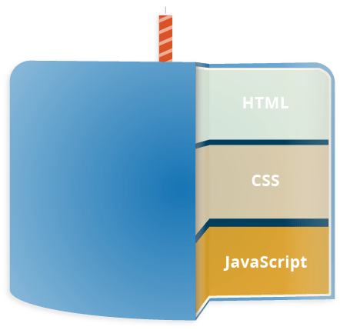
What is JavaScript?
JavaScript is a scripting language that enables you to create dynamically updating content, control multimedia, animate images, ….
It is the third layer of the layer cake of standard web technologies, two of which are HTML and CSS.

Slide 4
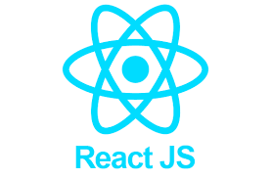


JAVASCRIPT TODAY
Front-end Developer
Back-end Developer
Full-stack Developer

Slide 5
JAVASCRIPT TODAY
Real-time Networking Apps
Web / Mobile Apps
Command-line Tools
Games

Slide 6
JavaScript Environments
Browser
Node
JavaScript Engine
Firefox: SpiderMonkey
Chrome: V8

Slide 7
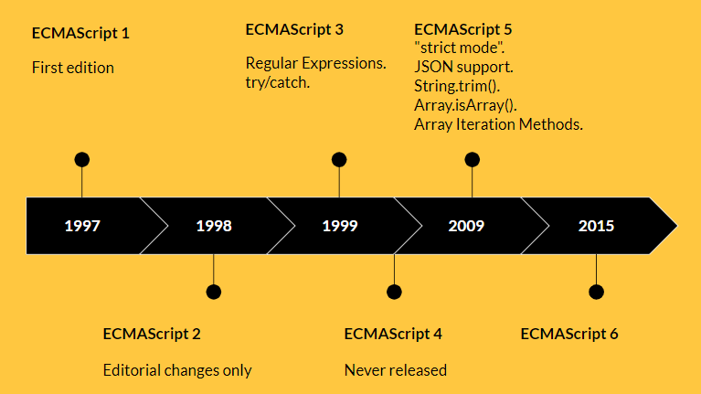
ECMAScript

Slide 8
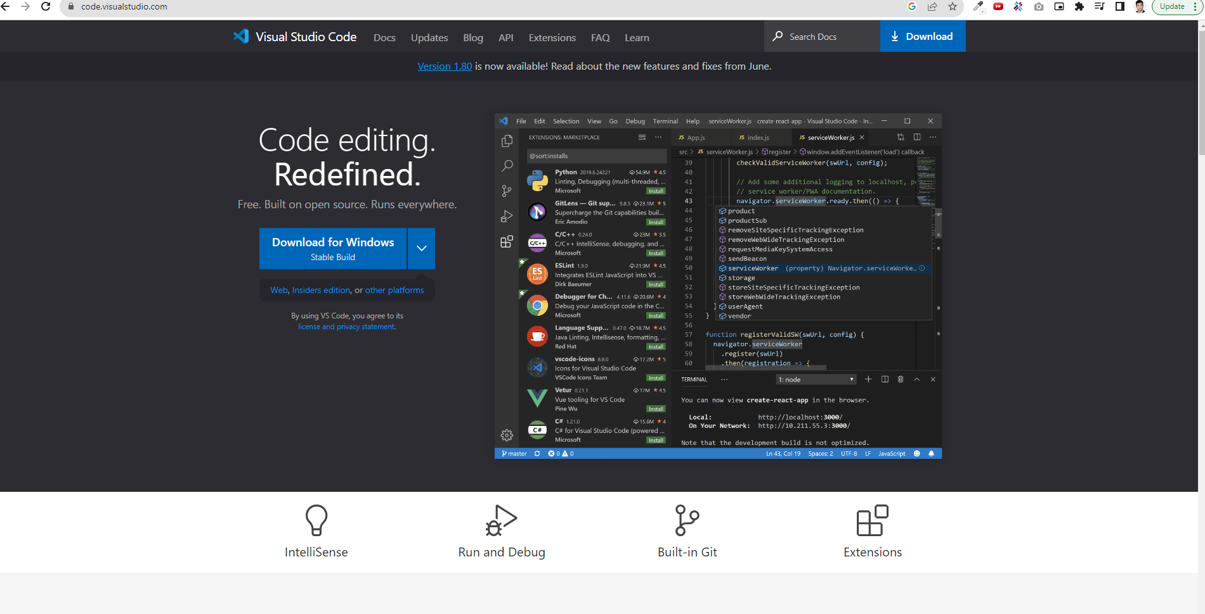
Editor

Slide 9
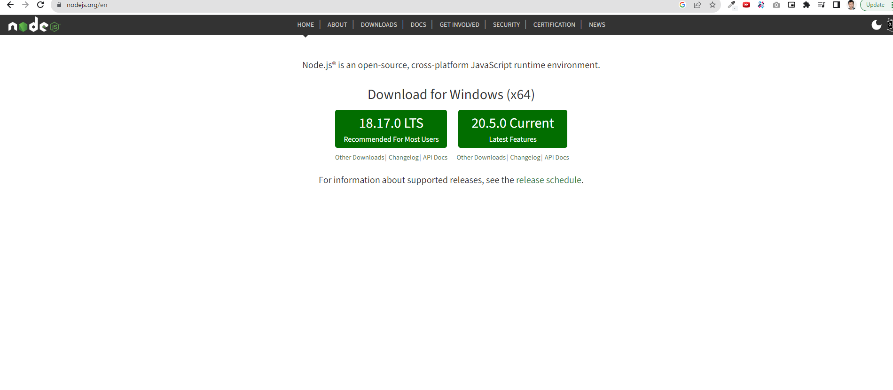
Node.js

Slide 10
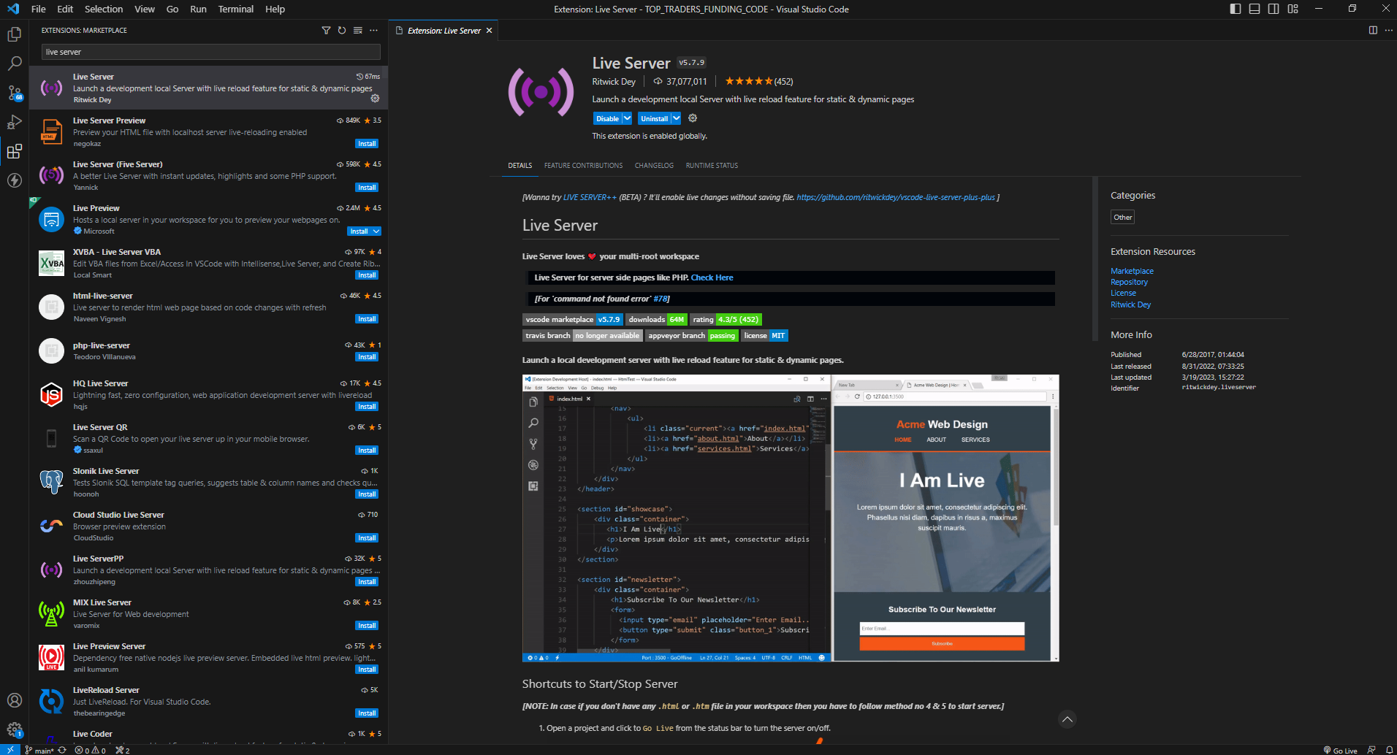
VSCode Extension
Live Server

Slide 11
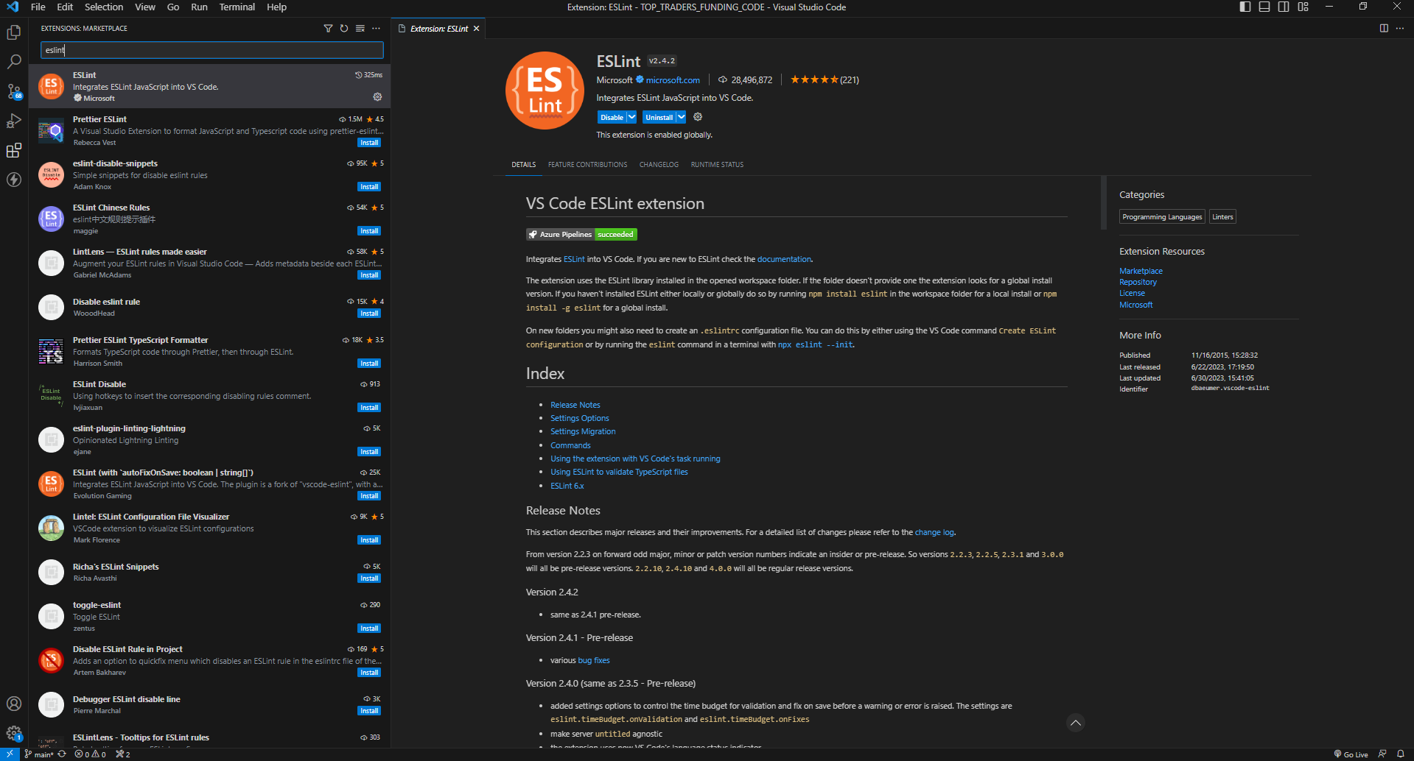
VSCode Extension
ESLint

Slide 12

Why is script tag at the bottom of HTML?
HTML is loaded and executed line by line. So, when the browser encounters a <script> tag, it loads and executes the JavaScript code on the spot. This may slow down the page rendering speed and thus webpage will take more time to load.

Slide 13
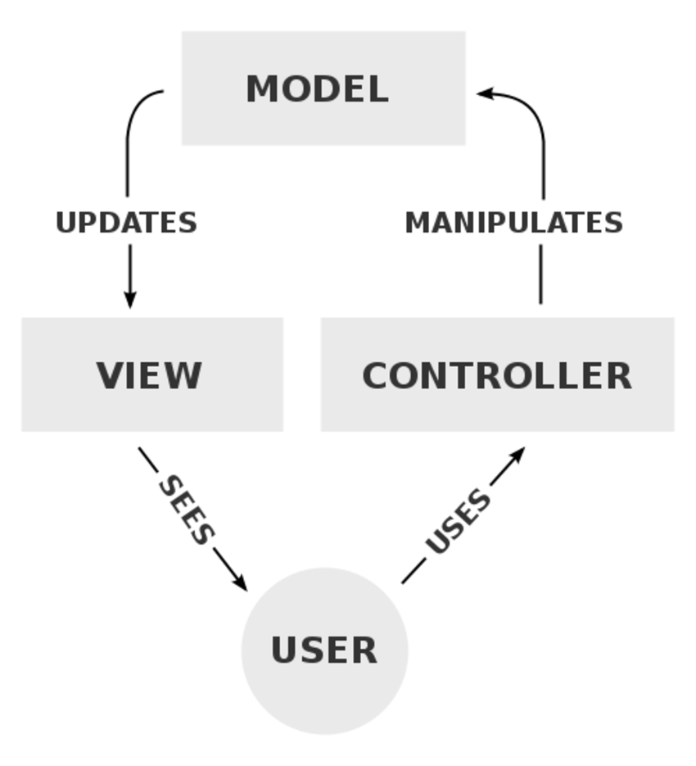
Separation of concerns
Separation of concerns is a principle used in programming to separate an application into units, with minimal overlapping between the functions of the individual units. The separation of concerns is achieved using modularization, encapsulation and arrangement in software layers.

Slide 14
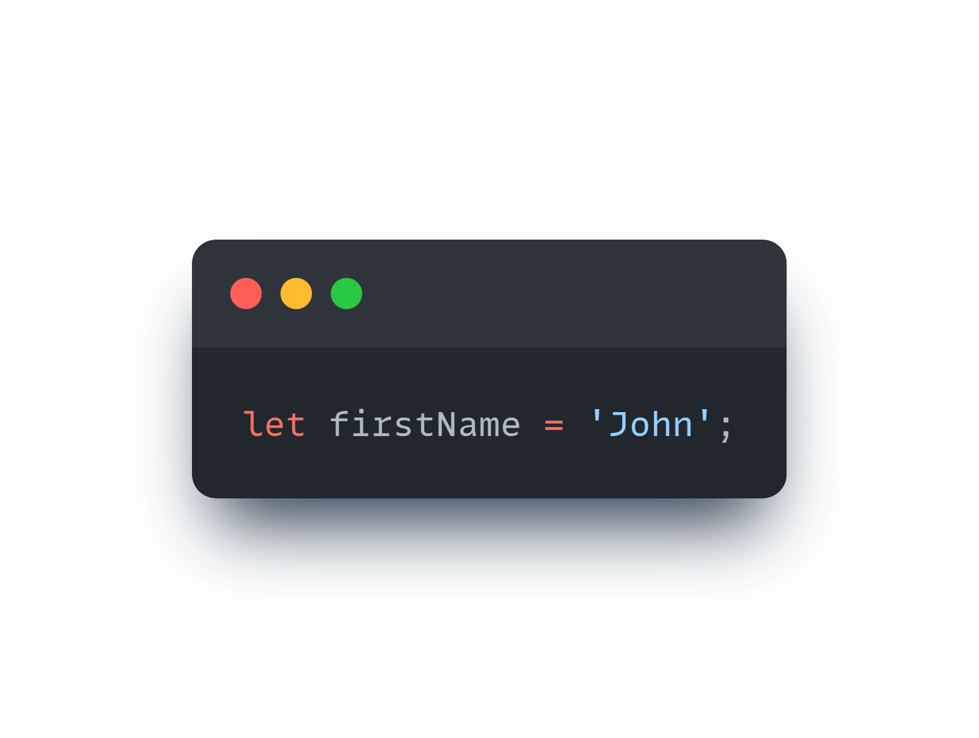
Variables
A variable is a named container for a particular type of data.
Variable name:
Cannot be a reserved keyword
Should be meaningful
Cannot start with a number
Cannot contain a space or hyphen
Are case-sensitive
let keyword

Slide 15
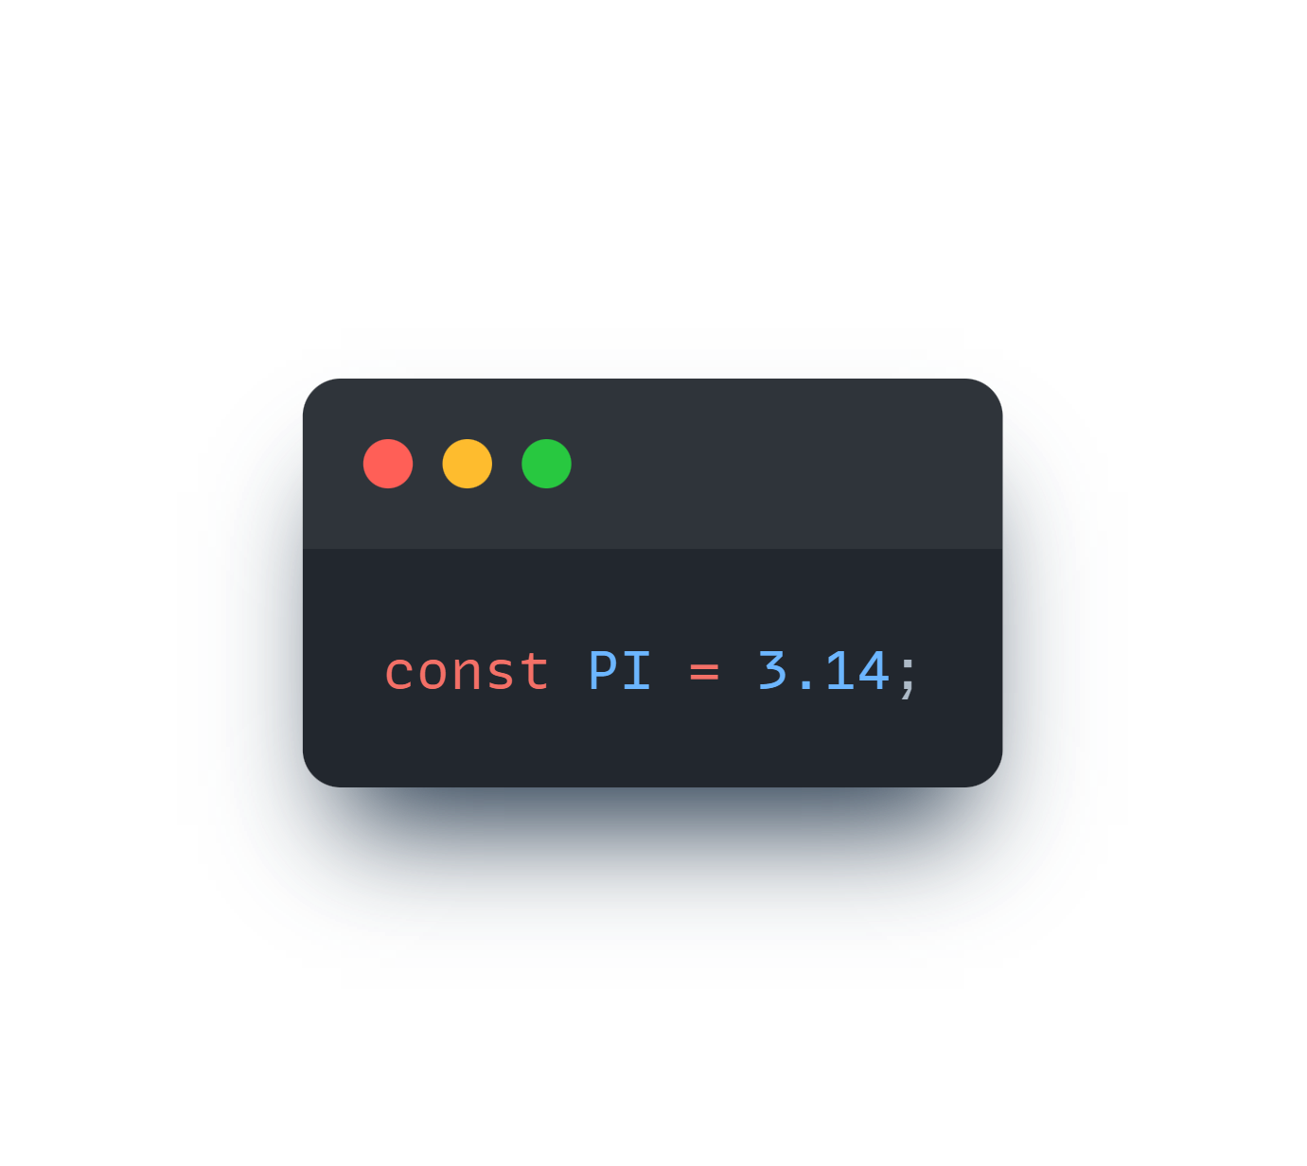
Constants
Constant is an entity that refers to a fixed value of data and which cannot be modified.
Constant name:
Cannot be a reserved keyword
Should be meaningful
Cannot start with a number
Cannot contain a space or hyphen
Are case-sensitive
Constants written in UPPERCASE
const keyword

Slide 16
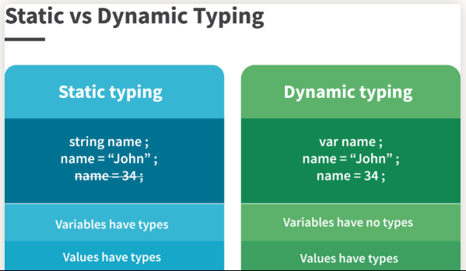
Statically vs Dynamically Typed Languages

Slide 17
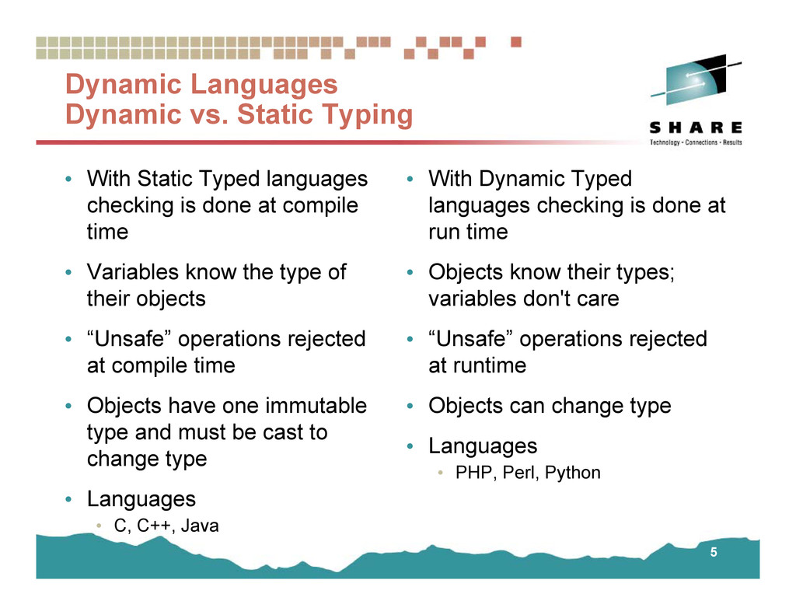
Statically vs Dynamically Typed Languages

Slide 18
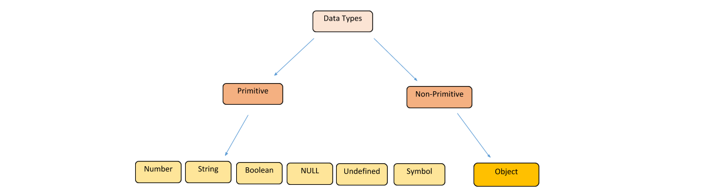
Data Types

Slide 19
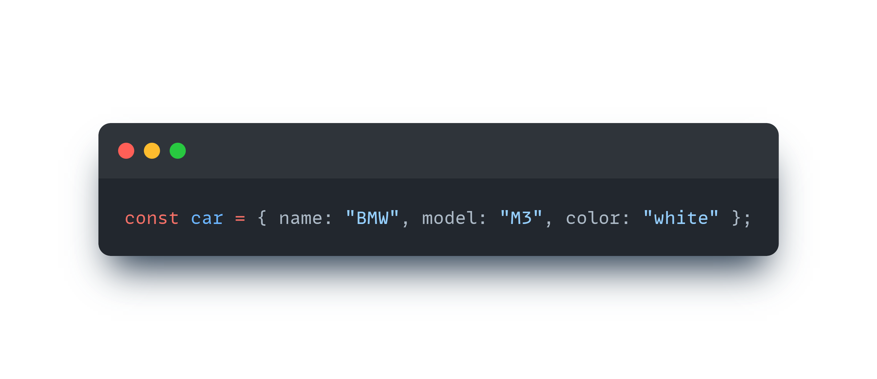
Objects
Object is a variable. But objects can contain many values. It will be assigned many values to a variable.
Object literal
car object has 3 properties (3 key/values).

Slide 20
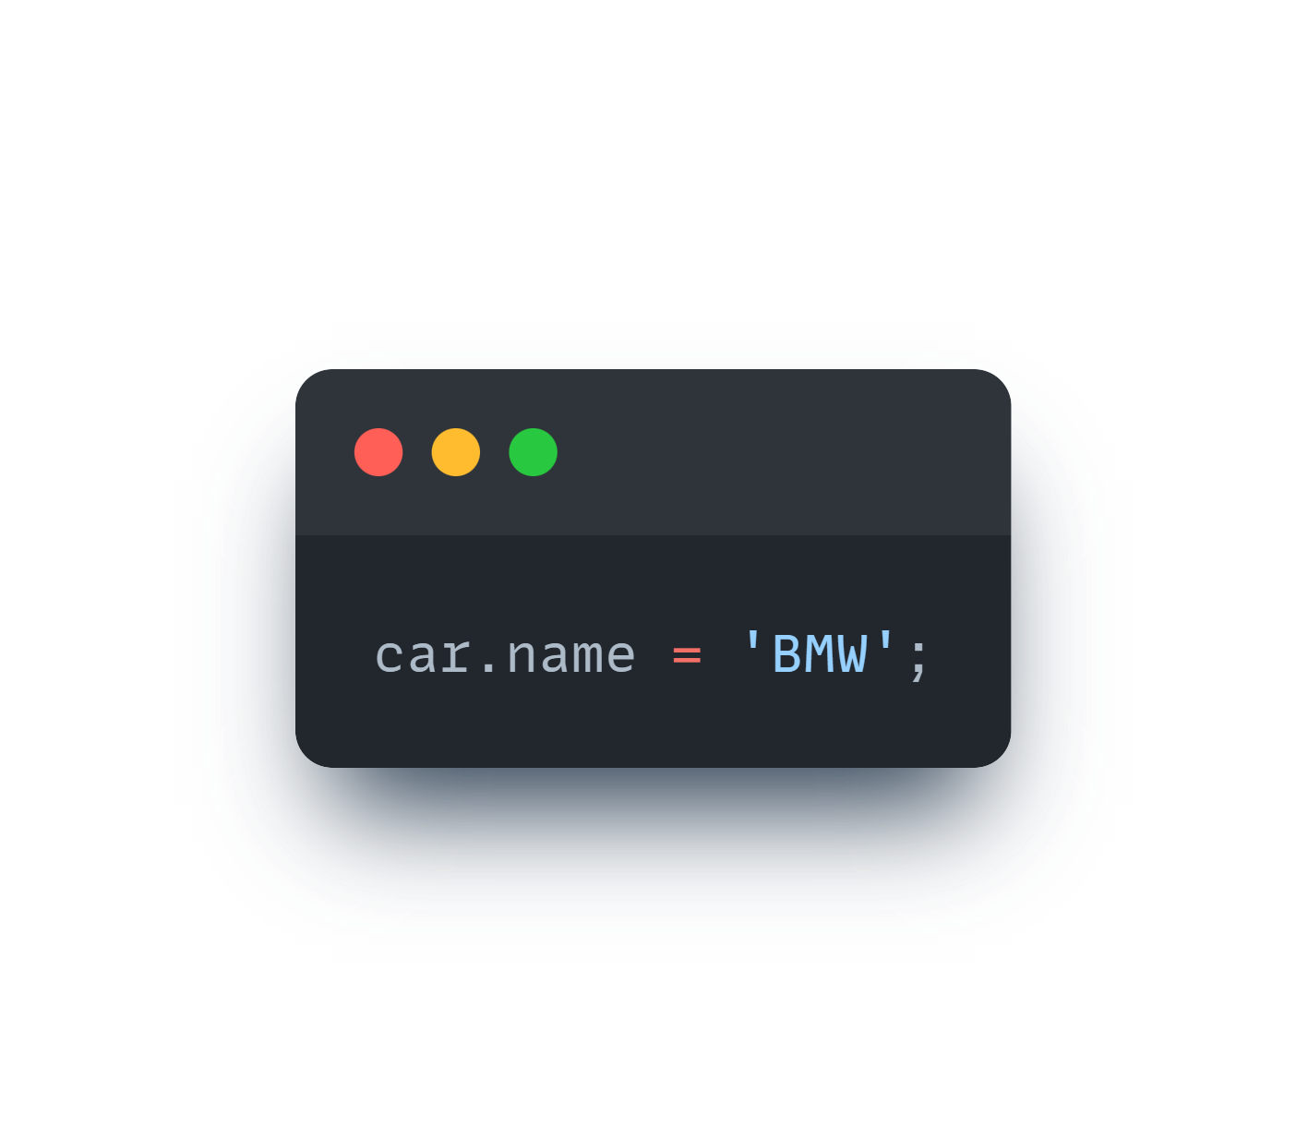
Accessing Object Properties
Dot Notation
Bracket Notation

Slide 21
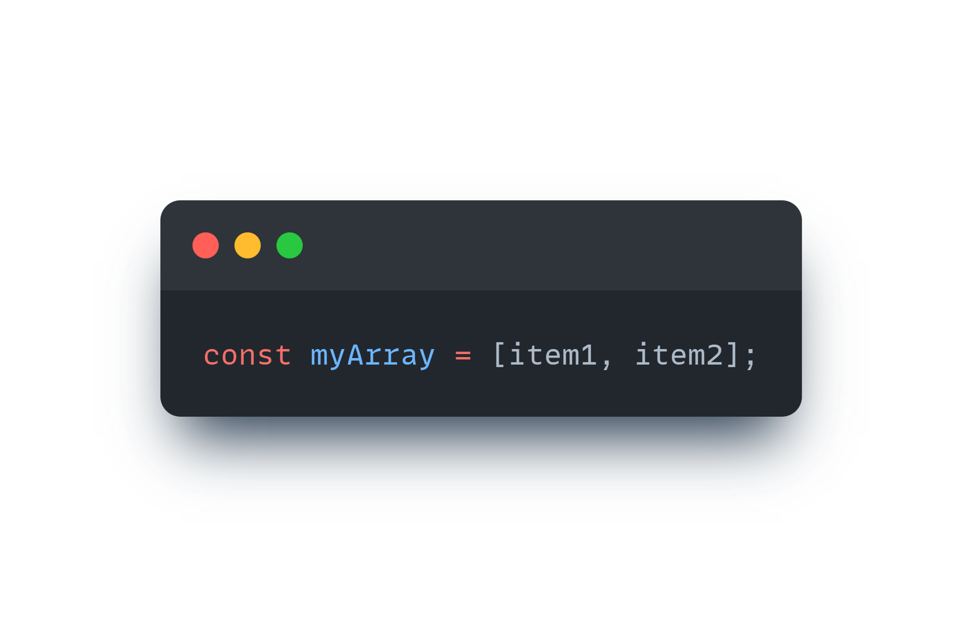
Arrays
An array can hold many values under a single name, and you can access the values by referring to an index number.
Creating an Array:
Array literal

Slide 22
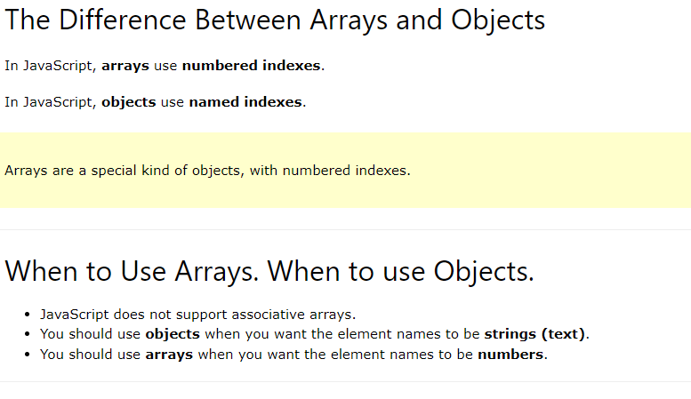
Arrays
Arrays are a special type of objects. The typeof operator in JavaScript returns "object" for arrays.

Slide 23
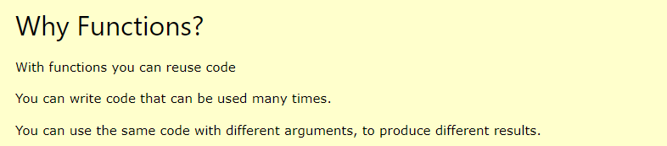
Functions
A JavaScript function is a block of code designed to perform a particular task.
A JavaScript function is executed when "something" invokes it (calls it).

Slide 24
Function Syntax
A JavaScript function is defined with the function keyword, followed by a name, followed by parentheses ().
Function names can contain letters, digits, underscores, and dollar signs (same rules as variables).
The parentheses may include parameter names separated by commas: (parameter1, parameter2, ...)
The code to be executed, by the function, is placed inside curly brackets: {}
function name(parameter1, parameter2, parameter3) { // code to be executed }
Function parameters are listed inside the parentheses () in the function definition.
Function arguments are the values received by the function when it is invoked.
Inside the function, the arguments (the parameters) behave as local variables.

Slide 25
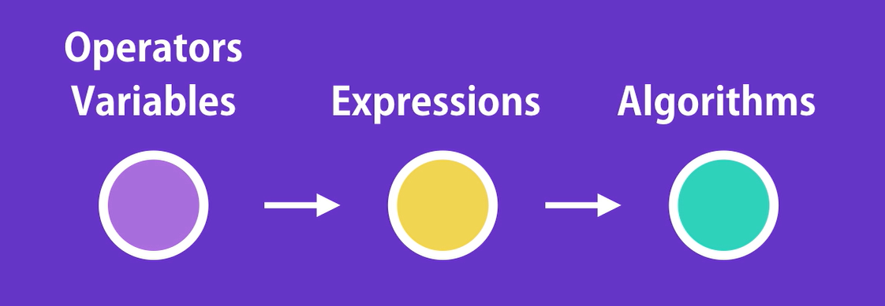
Operators

Slide 26
Types of Operators
Arithmetic Operators
Assignment Operators
Comparison Operators
String Operators
Logical Operators
Bitwise Operators
Ternary Operators
Type Operators

Slide 27
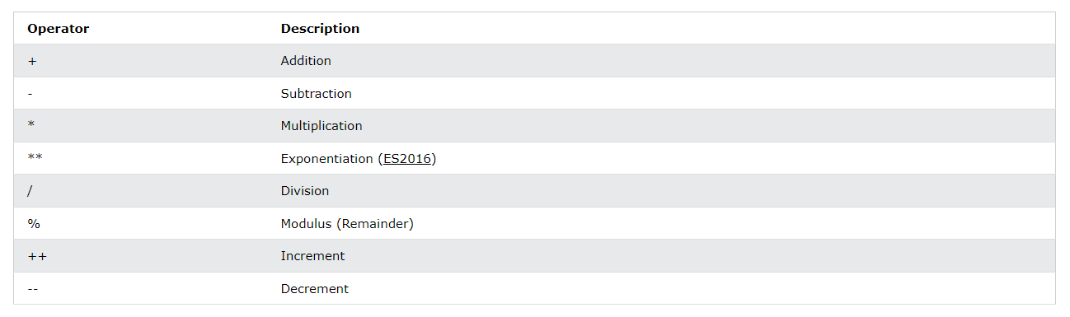
Arithmetic Operators

Slide 28
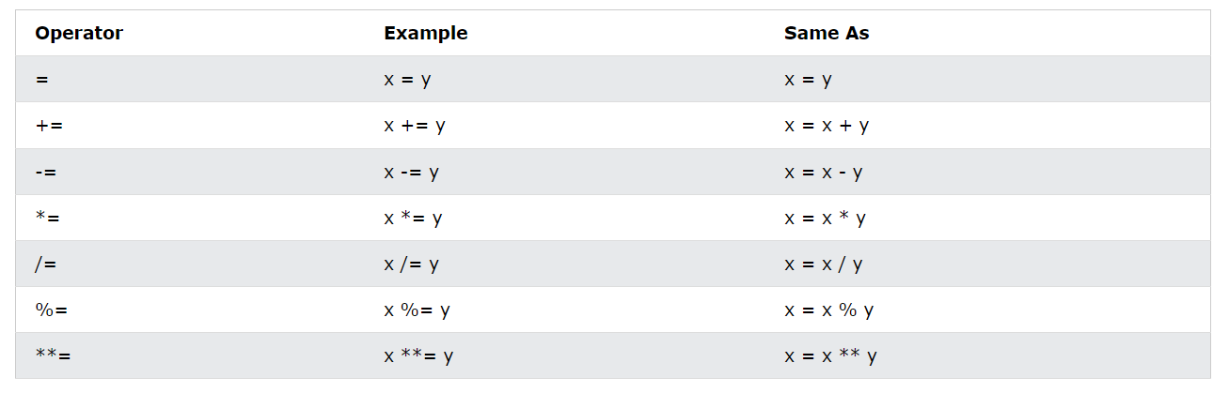
Assignment Operators

Slide 29
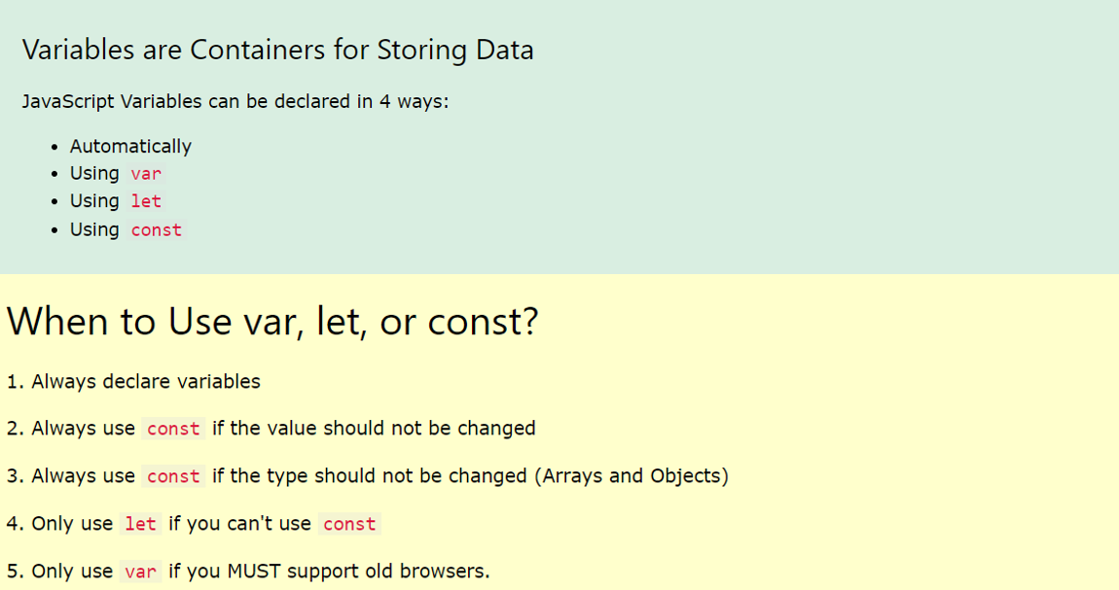
var / let / const

Slide 30
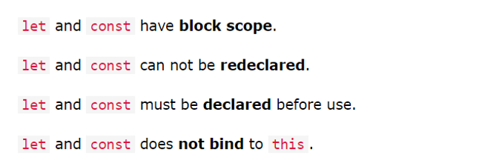
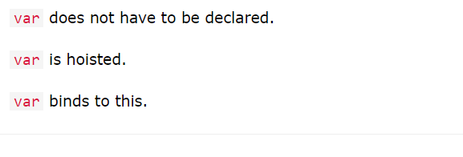
var / let / const

Slide 31
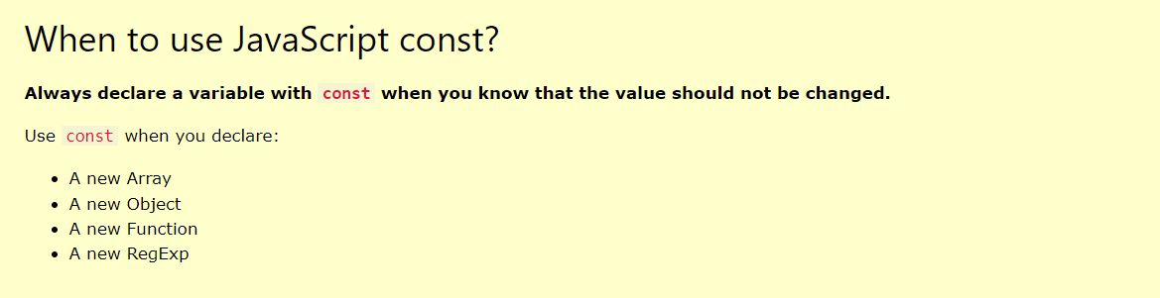
var / let / const

Slide 32
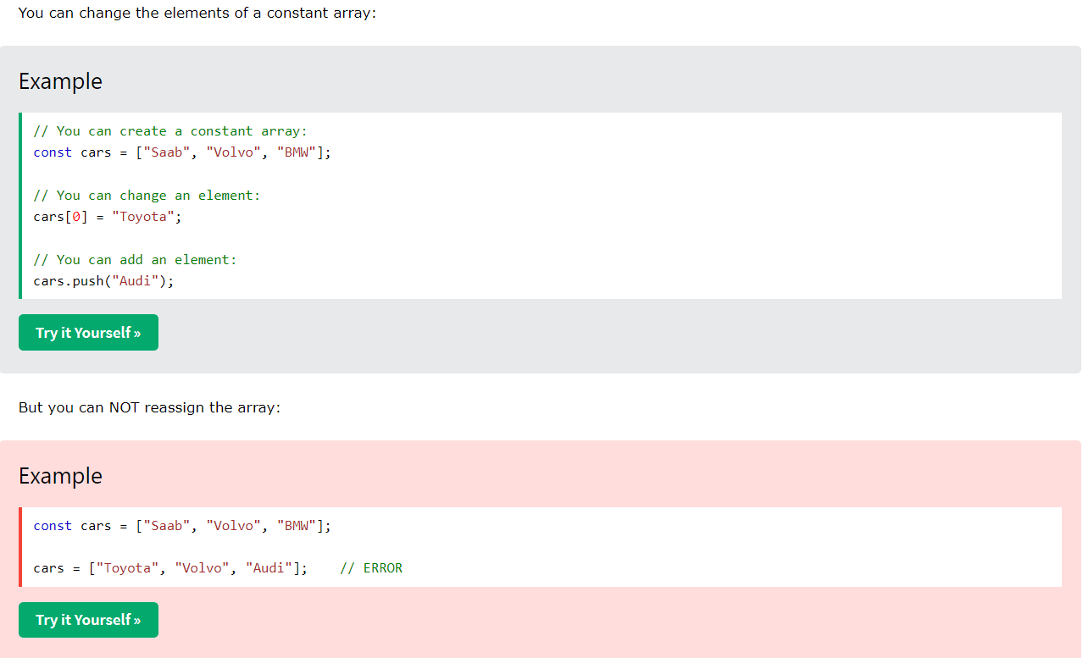
var / let / const

Slide 33
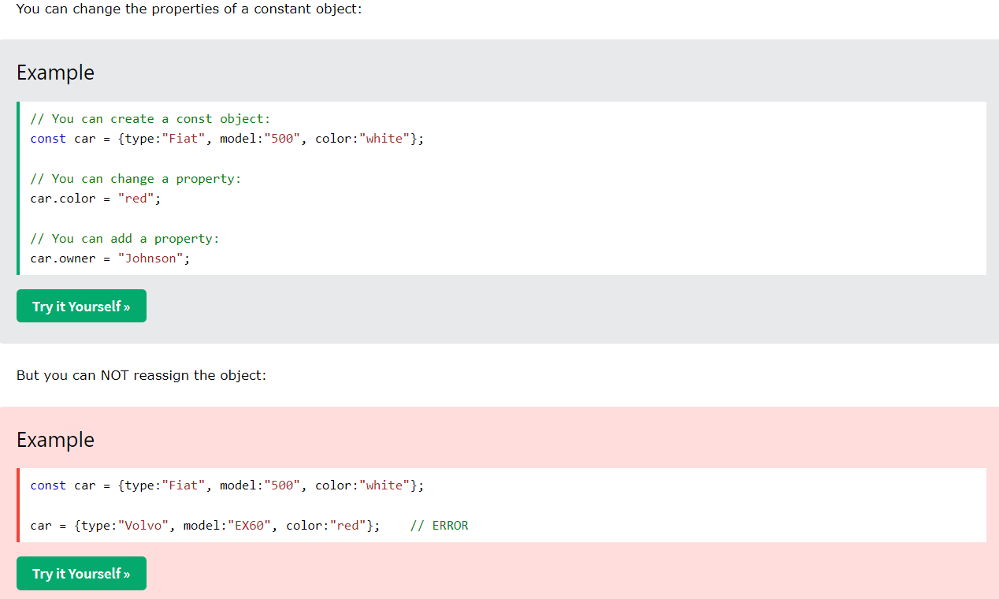
var / let / const

Slide 34
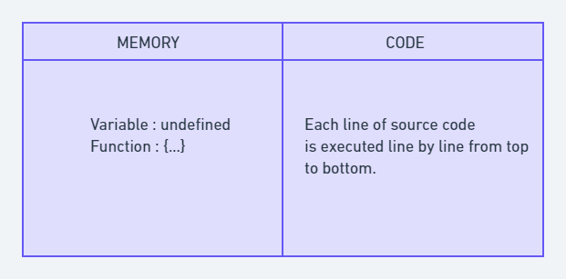
Execution Context
When the JavaScript engine scans a script file, it makes an environment called the Execution Context that handles the entire transformation and execution of the code.
During the context runtime, the parser parses the source code and allocates memory for the variables and functions. The source code is generated and gets executed.
Everything in JS happens inside this execution context. It is divided into two components. One is Memory / Variable Environment and the other is Code / Thread of Execution. It is important to remember that these phases and components are applicable to both global and functional execution contexts.

Slide 35
Execution Context types
There are two types of execution contexts: global and function.
The global execution context (GEC) is created when a JavaScript script first starts to run, and it represents the global scope in JavaScript.
A function execution context (FEC) is created whenever a function is called, representing the function's local scope.

Slide 36
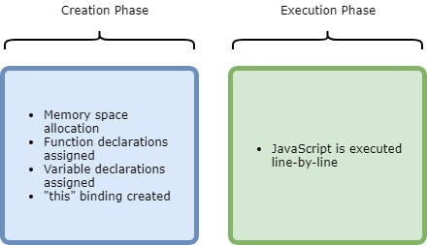
Execution Context Phases
There are two phases of JavaScript execution context:
Creation phase: In this phase, the JavaScript engine creates the execution context and sets up the script's environment. It determines the values of variables and functions and sets up the scope chain for the execution context.
Execution phase: In this phase, the JavaScript engine executes the code in the execution context. t processes any statements or expressions in the script and evaluates any function calls.

Slide 37
Execution Context
Everything in JS happens inside this execution context. It is divided into two components. One is Memory (Variable Environment) and the other is Code (Thread of Execution). It is important to remember that these phases and components are applicable to both global and functional execution contexts.

Slide 38
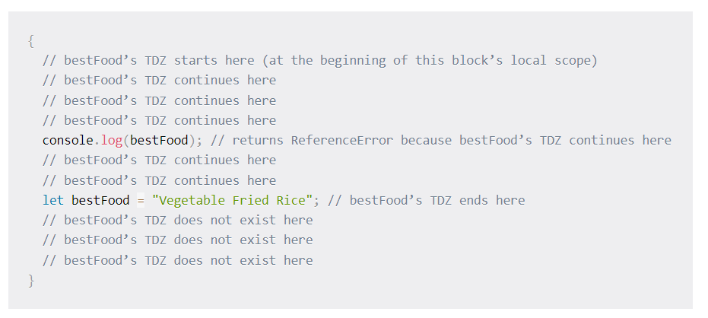
Temporal Dead Zone
A variable declared with let, const, or class is said to be in a "temporal dead zone" (TDZ) from the start of the block until code execution reaches the line where the variable is declared and initialized.

Slide 39
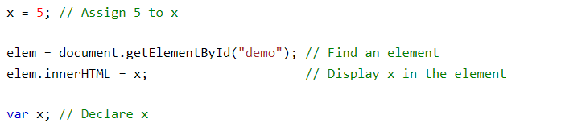
Hoisting
Hoisting is JavaScript's default behavior of moving declarations to the top.
In JavaScript, a variable can be declared after it has been used.
In other words; a variable can be used before it has been declared.

Slide 40
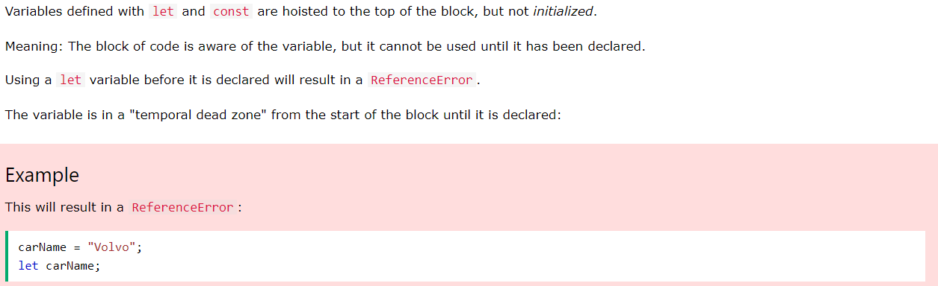
Hoisting

Slide 41
First-class Function
A programming language is said to have First-class functions when functions in that language are treated like any other variable. For example, in such a language, a function can be passed as an argument to other functions, can be returned by another function and can be assigned as a value to a variable.

Slide 42
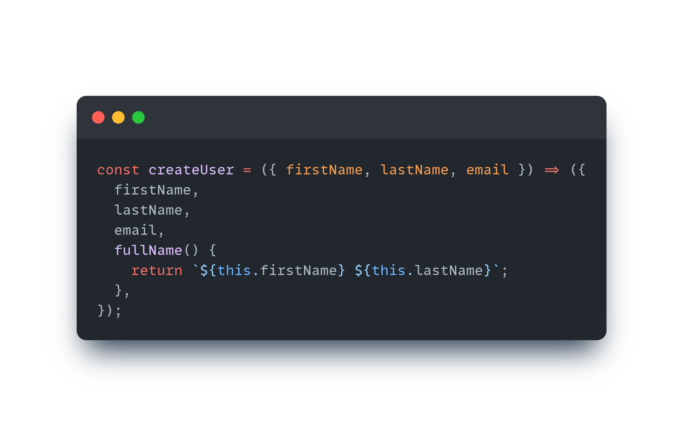
Factory Function
A function is a factory function when it returns a new object without the use of the new keyword!

Slide 43
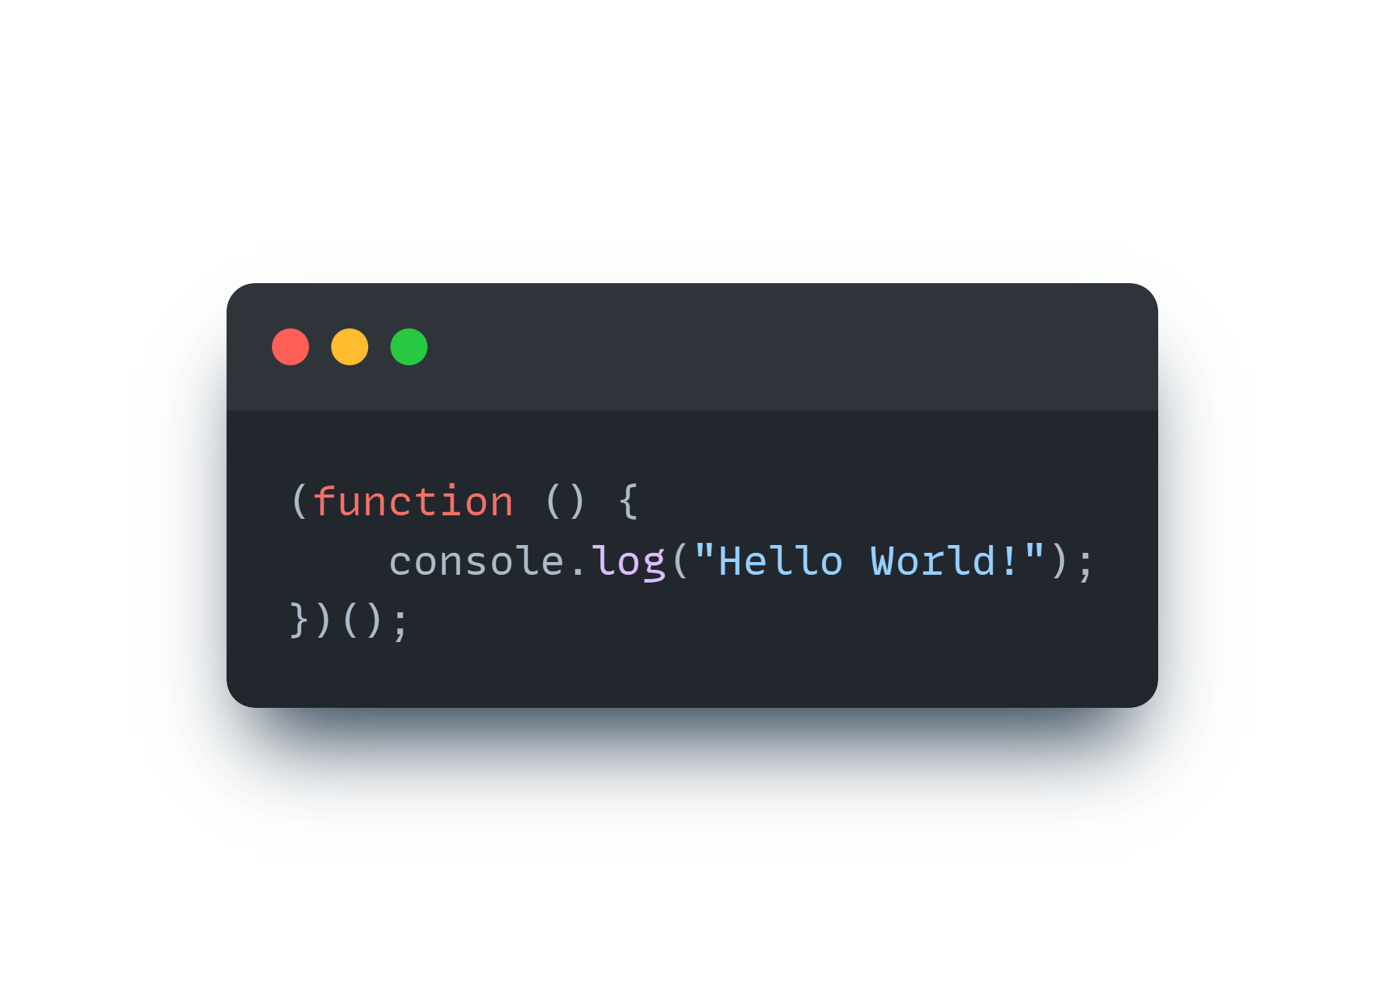
IIFE
An IIFE (Immediately Invoked Function Expression) is a JavaScript function that runs as soon as it is defined.

Slide 44
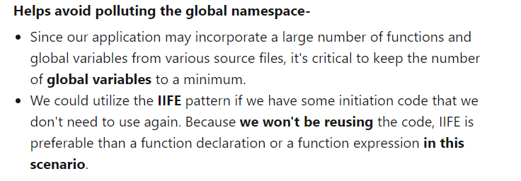
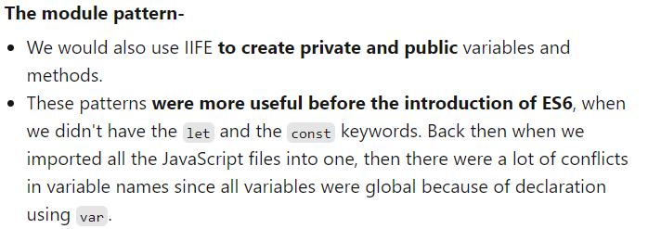
IIFE – Use cases

Slide 45
Arrow Function
In JavaScript, functions can be declared in two ways: normal / regular functions and arrow functions.

Slide 46
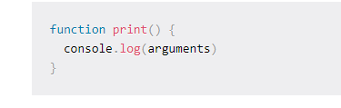
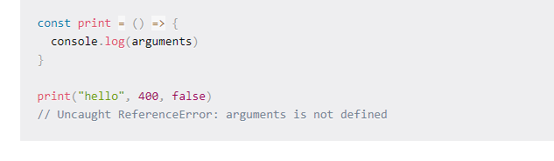
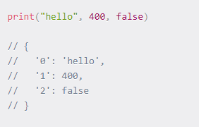
Arrow Function vs Normal Function
1. No arguments object in arrow functions
A normal function has an arguments object which you can access in the function, but this object
does not exist in arrow functions.

Slide 47
Arrow Function vs Normal Function
2. Arrow functions do not have their own value of this.

Slide 48
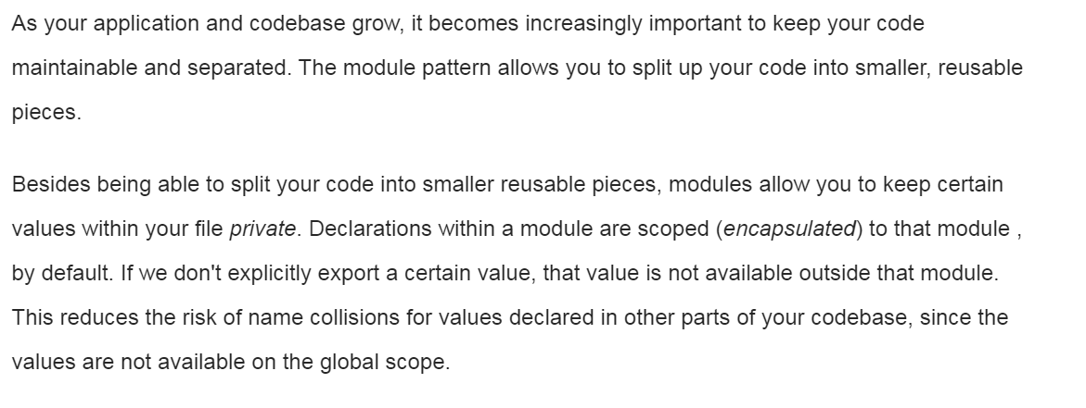
Module pattern
Split up your code into smaller, reusable pieces

Slide 49
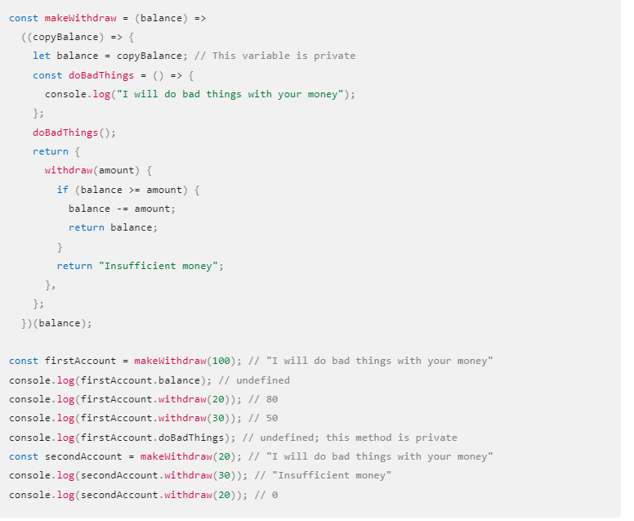
IIFE – Module pattern

Slide 50
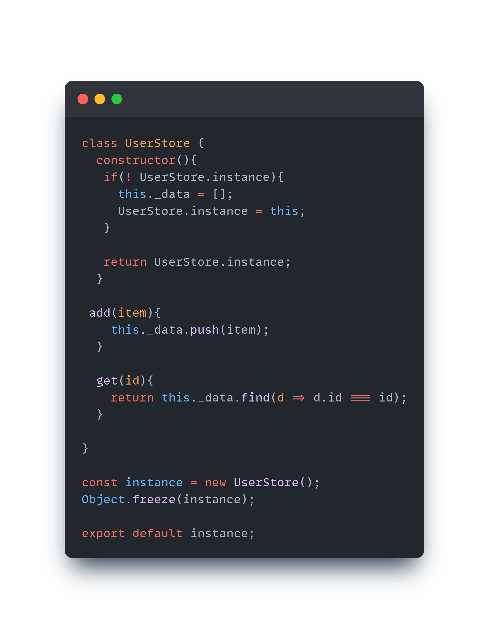
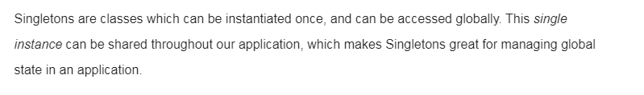
Singleton pattern
Share a single global instance throughout our application

Slide 51
Singleton pattern
The Singleton pattern solves two problems at the same time, violating the Single Responsibility Principle:
Ensure that a class has just a single instance. Why would anyone want to control how many instances a class has? The most common reason for this is to control access to some shared resource—for example, a database or a file.
Here’s how it works: imagine that you created an object, but after a while decided to create a new one. Instead of receiving a fresh object, you’ll get the one you already created.
Note that this behavior is impossible to implement with a regular constructor since a constructor call must always return a new object by design.

Slide 52
Singleton pattern
The Singleton pattern solves two problems at the same time, violating the Single Responsibility Principle:
2. Provide a global access point to that instance. Remember those global variables that you (all right, me) used to store some essential objects? While they’re very handy, they’re also very unsafe since any code can potentially overwrite the contents of those variables and crash the app.
Just like a global variable, the Singleton pattern lets you access some object from anywhere in the program. However, it also protects that instance from being overwritten by other code.
There’s another side to this problem: you don’t want the code that solves problem #1 to be scattered all over your program. It’s much better to have it within one class, especially if the rest of your code already depends on it.

Slide 53
Singleton pattern - Solution
All implementations of the Singleton have these two steps in common:
Make the default constructor private, to prevent other objects from using the new operator with the Singleton class.
Create a static creation method that acts as a constructor. Under the hood, this method calls the private constructor to create an object and saves it in a static field. All following calls to this method return the cached object.
If your code has access to the Singleton class, then it’s able to call the Singleton’s static method. So whenever that method is called, the same object is always returned.

Slide 54
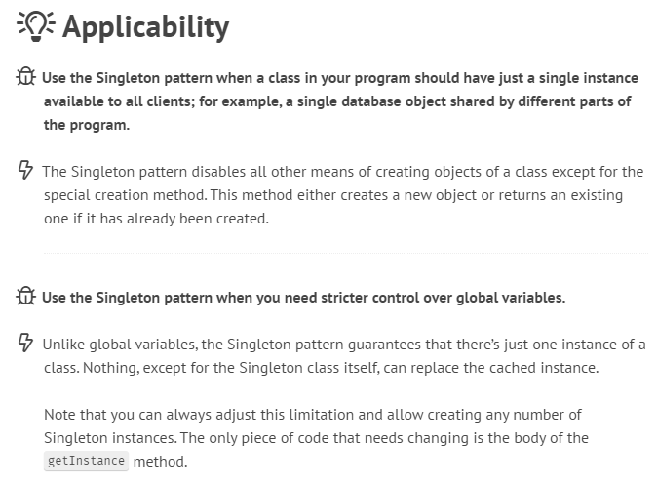
Singleton pattern - Applicability

Slide 55
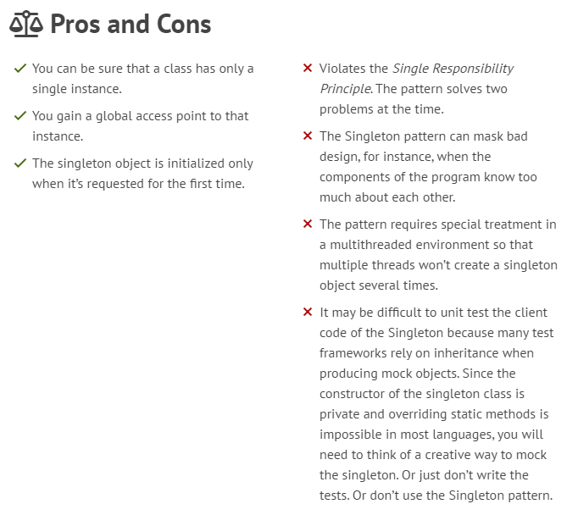
Singleton pattern - Pros and Cons

Slide 56
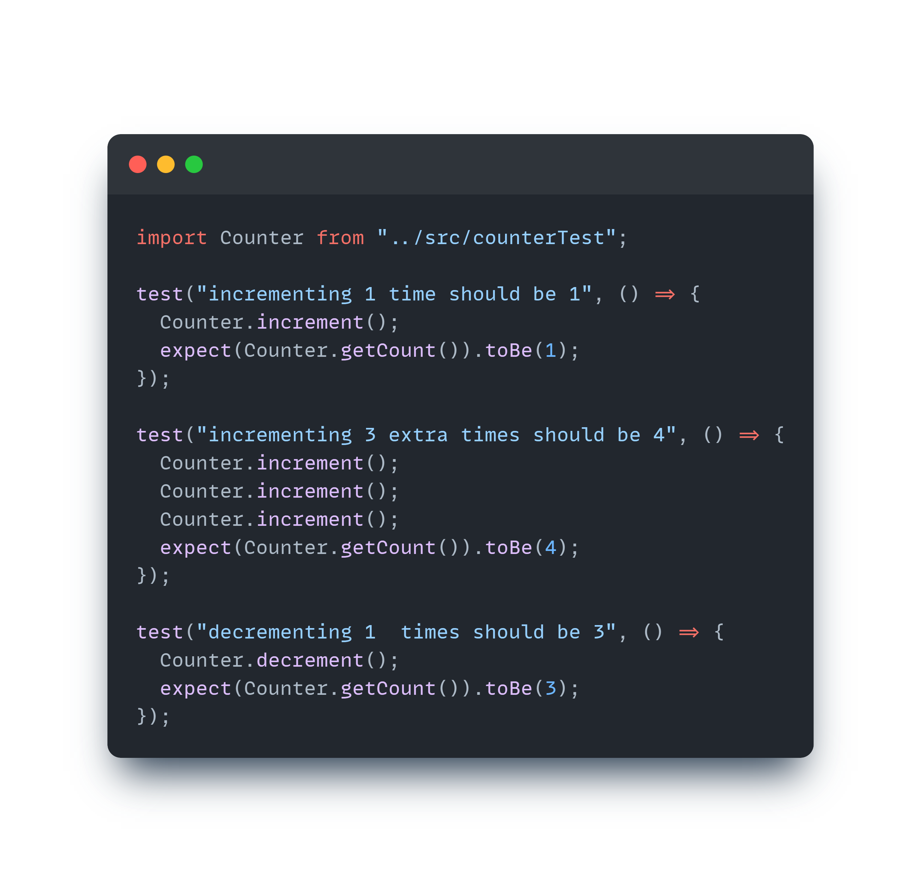
Singleton pattern - Testing
Testing code that relies on a Singleton can get tricky. Since we can't create new instances each time, all tests rely on the modification to the global instance of the previous test. The order of the tests matter in this case, and one small modification can lead to an entire test suite failing. After testing, we need to reset the entire instance in order to reset the modifications made by the tests.

Slide 57
New under the hood

